Slide 1
Using Invariants in Design and Implementation of ADTs
Neeraj Jain
Arun Taneja

Slide 2
Content
invariants
abstraction functions
documentation
Notes:
Immutable variables
In imperative programming, values held in program variables whose content never changes are known as constants to differentiate them from variables that could be altered during execution. Read-only fields may be calculated when the program runs (unlike constants, which are known beforehand), but never change after they are initialized.
References to objects
In most object-oriented languages, objects can be referred to using references. Some examples of such languages are Java, C++, C#, VB.NET, and many scripting languages, such as Perl, Python, and Ruby. In this case, it matters whether the state of an object can vary when objects are shared via references.
Copying objects
If an object is known to be immutable, it can be copied simply by making a copy of a reference to it instead of copying the entire object. Because a reference (typically only the size of a pointer) is usually much smaller than the object itself, this results in memory savings and a potential boost in execution speed.

Slide 3
Invariant
An invariant is a property of a program that
is always true, for every possible runtime
state of the program.
Immutability is one crucial invariant that we’ve already encountered: once created, an immutable object should always represent the same value, for its entire lifetime.
Notes:
Immutable variables
In imperative programming, values held in program variables whose content never changes are known as constants to differentiate them from variables that could be altered during execution. Read-only fields may be calculated when the program runs (unlike constants, which are known beforehand), but never change after they are initialized.
References to objects
In most object-oriented languages, objects can be referred to using references. Some examples of such languages are Java, C++, C#, VB.NET, and many scripting languages, such as Perl, Python, and Ruby. In this case, it matters whether the state of an object can vary when objects are shared via references.
Copying objects
If an object is known to be immutable, it can be copied simply by making a copy of a reference to it instead of copying the entire object. Because a reference (typically only the size of a pointer) is usually much smaller than the object itself, this results in memory savings and a potential boost in execution speed.

Slide 4
Invariant and Abstract data types
An abstract data type (ADT) is a type equipped with a set of operations for manipulating values of that type.
ADT is implemented by providing a representation type for the values of the ADT and an implementation for the operations defined on values of the representation type.
Notes:
What makes an ADT abstract is that the representation type is hidden from clients of the ADT.
Consequently, the only operations that may be performed on a value of the ADT are the given ones.
This ensures that the representation may be changed without affecting the behavior of the client --- since the representation is hidden from it, the client cannot depend on it.

Slide 5
Invariant and Abstract data types
Saying that the ADT preserves its own invariants means that the ADT is responsible for ensuring that its own invariants hold. It doesn't depend on good behavior from its clients.
When an ADT preserves its own invariants, reasoning about the code becomes much easier.
Notes:
What makes an ADT abstract is that the representation type is hidden from clients of the ADT.
Consequently, the only operations that may be performed on a value of the ADT are the given ones.
This ensures that the representation may be changed without affecting the behavior of the client --- since the representation is hidden from it, the client cannot depend on it.

Slide 6
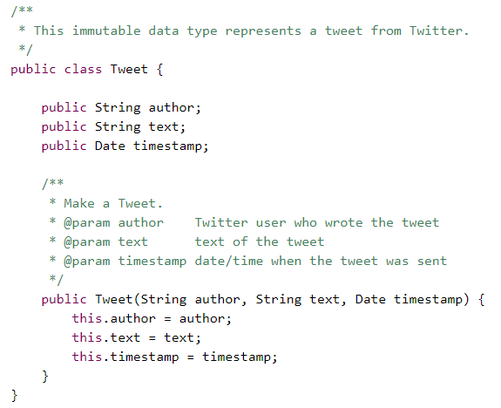
Example
Notes:
What makes an ADT abstract is that the representation type is hidden from clients of the ADT.
Consequently, the only operations that may be performed on a value of the ADT are the given ones.
This ensures that the representation may be changed without affecting the behavior of the client --- since the representation is hidden from it, the client cannot depend on it.

Slide 7
Invariant and Abstract data types
Notes:
What makes an ADT abstract is that the representation type is hidden from clients of the ADT.
Consequently, the only operations that may be performed on a value of the ADT are the given ones.
This ensures that the representation may be changed without affecting the behavior of the client --- since the representation is hidden from it, the client cannot depend on it.

Slide 8
Invariant and Abstract data types
Tweet tweet = new Tweet("narendramodi“
, “Mitro kaise ho“
,new Date());
tweet.author = "rbmllr";
Notes:
What makes an ADT abstract is that the representation type is hidden from clients of the ADT.
Consequently, the only operations that may be performed on a value of the ADT are the given ones.
This ensures that the representation may be changed without affecting the behavior of the client --- since the representation is hidden from it, the client cannot depend on it.

Slide 9
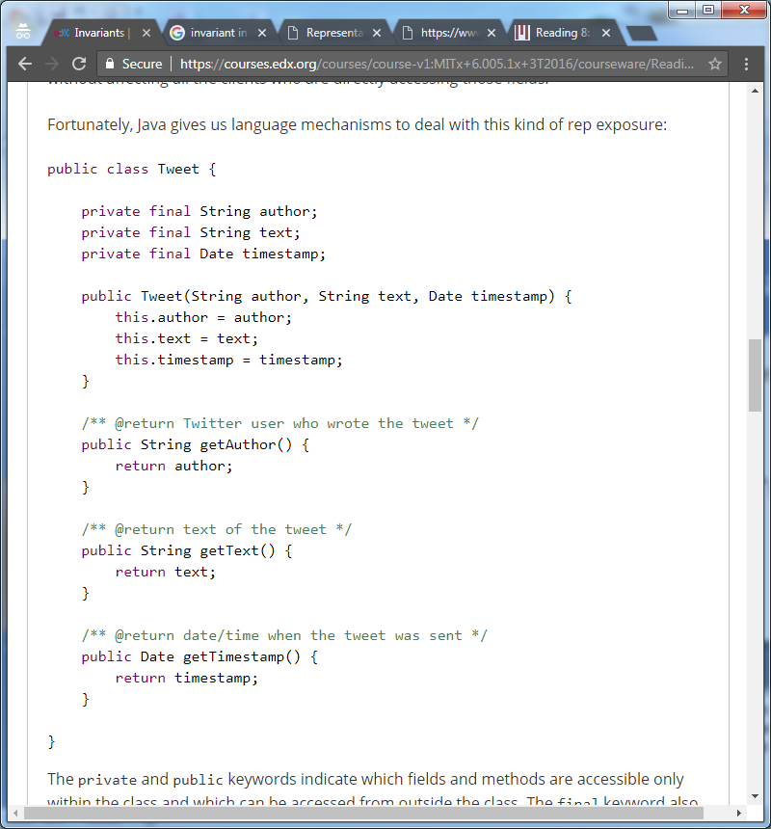
Invariant and Abstract data types
No property is accessible outside the Tweet Class.
Notes:
What makes an ADT abstract is that the representation type is hidden from clients of the ADT.
Consequently, the only operations that may be performed on a value of the ADT are the given ones.
This ensures that the representation may be changed without affecting the behavior of the client --- since the representation is hidden from it, the client cannot depend on it.

Slide 10
Invariant and Abstract data types
public static Tweet retweetLater(Tweet t) {
Date d = t.getTimestamp();
d.setHours(d.getHours()+1);
return new Tweet("rbmllr", t.getText(), d);
}
Notes:
/** @return a tweet that retweets t, one hour later*/

Slide 11
Invariant and Abstract data types
public Tweet(String author, String text, Date timestamp) {
this.author = author;
this.text = text;
this.timestamp = new Date(timestamp.getTime());
}
Notes:
/** @return a tweet that retweets t, one hour later*/

Slide 12
Other possible examples
A card game having 52 cards.

Slide 13
Other possible examples
Arithmetic progression series

Slide 14
Summary
Representation invariants are a mathematical tool for checking the correctness of implementations of abstract data types (ADTs).
A set of invariants are defined which together guarantee the internal consistency of the data structure.
A good ADT preserves its own invariants.
Invariants must be established by creators and producers and preserved by observers and mutators.
A set of invariants are defined which together guarantee the internal consistency of the data structure.

Slide 15
Thanks

